Slide 1
A study on suggestion of predicates using the clustering of item names for making RDF of Open Data
BO CHEN
Kagoshima University, Japan
Notes:
Thank you Mr. Chairman
My name is Bo Chen，I am from Kagoshima University.
Now,I’d like to give a talk about `A study on suggestion of predicates using the clustering of item names for making RDF of Open Data’.

Slide 2
Contents
Introduction
  Open Data
  Five stages
  RDF triple
Our search approach
  Word2vec
  Experiment
Experimental results
Conclusion
Notes:
This is the Contents of my presentation.
I’ve divided my talk into four parts:
the Introduction, Our search approach ,the results, and the Conclusion.

Slide 3
Introduction
The utilization of Open Data is promoted
Open Data is defined by MIC
  Open Data is data formats that are suitable for machine reading
  and data that have been released on the use of rules that allows secondary use,
  which allows secondary use without requiring a lot of manpower
To put it briefly, “Open Data is available to everyone and is free to use, reuse, and redistribute”.
Notes:
The utilization of Open Data is promoted
What’s Open Data? “Open Data is available to everyone and is free to use, reuse, and redistribute([ˌriːdɪˈstrɪbjuːt] )”.
3

Slide 4
What’s RDF triple?
RDF is a file format with elements of combination
  three elements
    a subject
    a predicate
    an object
RDF graph example:
John
plays
football
Subject
Predicate
Object
 | plays | likes | eats
John | football | car | fish
Bill | basketball | bike | apple
Notes:
RDF is a file format with elements of combination.
Three elements is a subject, a predicate and an object.
For example,”John plays football”.’John’ is subject.’plays’ is predicate,’football’ is object.
4

Slide 5
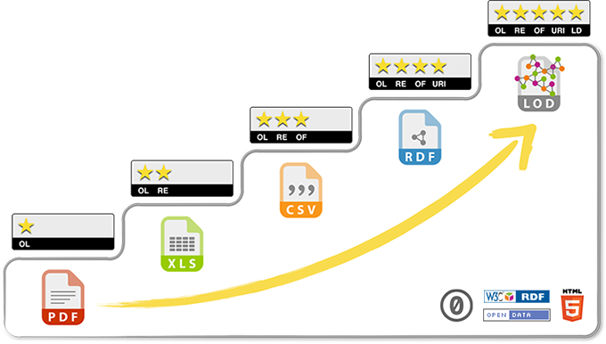
Five stages of data format
A 5-star deployment scheme for Open Data was suggested by Tim Berners-Lee
  Open data of local governments was opened as CSV format.CSV format is third stage in the 5-star deployment scheme.
  We focused on RDF format of 4th stage.
  RDF is a file format with elements of combination.
Fig. 1. Five stars deployment scheme for Open Data
Notes:
As we all know, A 5-star deployment scheme for Open Data was suggested by Tim Berners-Lee
Open data of local governments was opened as CSV format.CSV format is third stage in the 5-Star Data Schema
IN this study We focused on RDF format of 4th stage. RDF is a file format with elements of combination
5

Slide 6
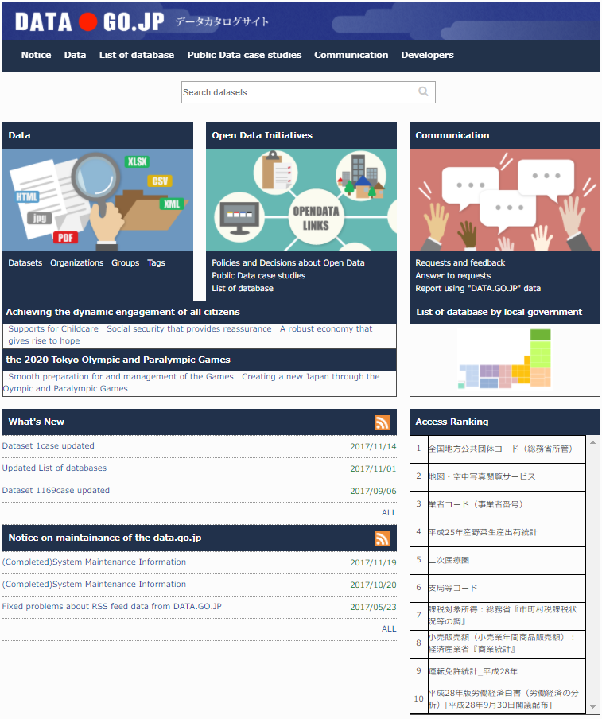
Open data in government
IT Strategic Headquarters published an Electronic government Open Data strategy in 2012.
“G8 Open Data Charter” was presented in 2013, efforts to Open Data has begun in each country.
The Data catalog site is published by Japanese government.
Fig. 2. Top page of DATA.GO.JP
Notes:
IT Strategic Headquarters published an Electronic government Open Data strategy in 2012.
“G8(「Group of Eight」) Open Data Charter” was presented in 2013, efforts to Open Data has begun in each country.
The Data catalog site is published by Japanese government.
This picture is homepage of the site.
6

Slide 7
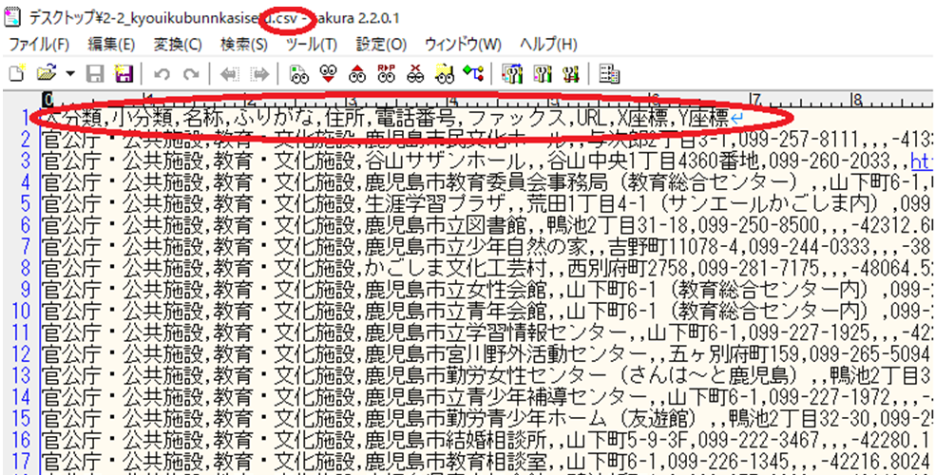
Open data of Kagoshima city
Fig. 3. Content of CSV file
Notes:
Open data of Kagoshima City was published in July,2016 as CSV format. it’s not suitable for machine reading .
This picture shows content of CSV file .
It is the fact that local governments possess huge amounts of public data released as Open Data without cooperation of each data.
7

Slide 8
Contents
Introduction
  Open Data
  Five stages
  RDF triple
Our search approach
  Word2vec
  Experiment
Experimental results
Conclusion
Notes:
Now, we focused on the vocabulary that corresponds to the predicate of RDF form for Open Data, and proposed a method to suggest predicates by the clustering of item names for RDF of Open Data.
and I will talk briefly about Word2Vec which is needed for Our study.
I will introduce the algorithm later.

Slide 9
What’s Word2Vec?
Word2Vec is a method of a natural language.
It enables the vector operation based on the meaning of the word and performs learning as an input sentence and maps many words to vector space
Word2Vec has been applied in various fields recently.
  Word similarity = vector similarity
  Key idea: Predict surrounding words of every word
  Represent each word with a low-dimensional vector
Notes:
Word2Vec, a method of a natural language.
It enables the vector operation based on the meaning of the word, performs learning as an input sentence and maps many words to vector space.
Word2Vec has been applied in various fields recently.
9

Slide 10
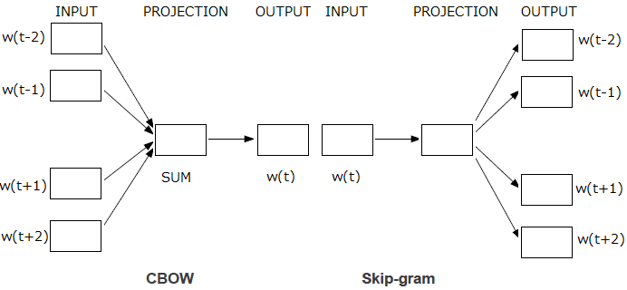
Model： CBOW and Skip-gram
two models– CBOW and Skip-gram:
  Continuous Bag of Word (CBOW): use a window of word to predict the middle word
  Skip-gram (SG): use a word to predict the surrounding ones in window
Fig. 4. Model of Wor2Vec
Notes:
Word2Vec have two models– CBOW and Skip-gram.
CBOW use a window of word to predict the middle word.Skip-gram (SG) use a word to predict the surrounding ones in window.
10

Slide 11
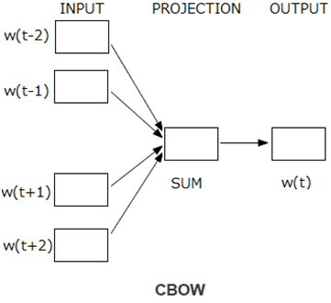
Sample of CBOW
E.g. “The dog sat on chair”
  Window size = 2
the
dog
sat
on
chair
Notes:
This is sample of CBOW model. For example, “The dog sat on chair” Input is ‘The dog on chair’.Ouput is ‘sat’
11

Slide 12
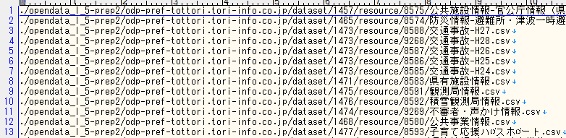
Process flow
START
Get the csv file from open Data
End judgment
Fig. 5. List of CSV file
Extract item names and item data separated by the word segmentation
Create vectors of item names and item with Word2Vec
Perform hierarchical clustering by vectors of item names.
Use Keras to learn for suggestion of predicates by inputting vectors of item data separated and the clustering of item names as teacher signal in output layer.
END
Notes:
NOW I introduce the algorithm.
First of all, We get the csv file from Open Data of local governments that have already been published.
12

Slide 13
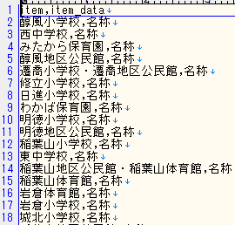
Process flow
START
Get the csv file from open Data
End judgment
Extract item names and item data separated by the word segmentation
Create vectors of item names and item with Word2Vec
Perform hierarchical clustering by vectors of item names.
Use Keras to learn for suggestion of predicates by inputting vectors of item data separated and the clustering of item names as teacher signal in output layer.
Fig. 6. Extracted item names and item data
END
Notes:
Secondly, we extract item names and item data, then separate words in Japanese with spaces by the word segmentation from the csv file. The word segmentation is called Janome.
13

Slide 14
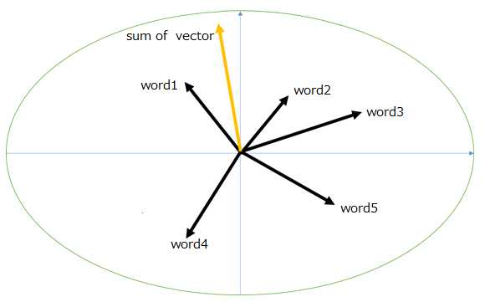
Process flow
START
Get the csv file from open Data
End judgment
Extract item names and item data separated by the word segmentation
Create vectors of item names and item with Word2Vec
Perform hierarchical clustering by vectors of item names.
Use Keras to learn for suggestion of predicates by inputting vectors of item data separated and the clustering of item names as teacher signal in output layer.
Fig. 7. Composite vectors of Words in words space
END
Notes:
And then, we create vectors of item names and item data with Word2Vec,and then composite vectors of Words in words space
14

Slide 15
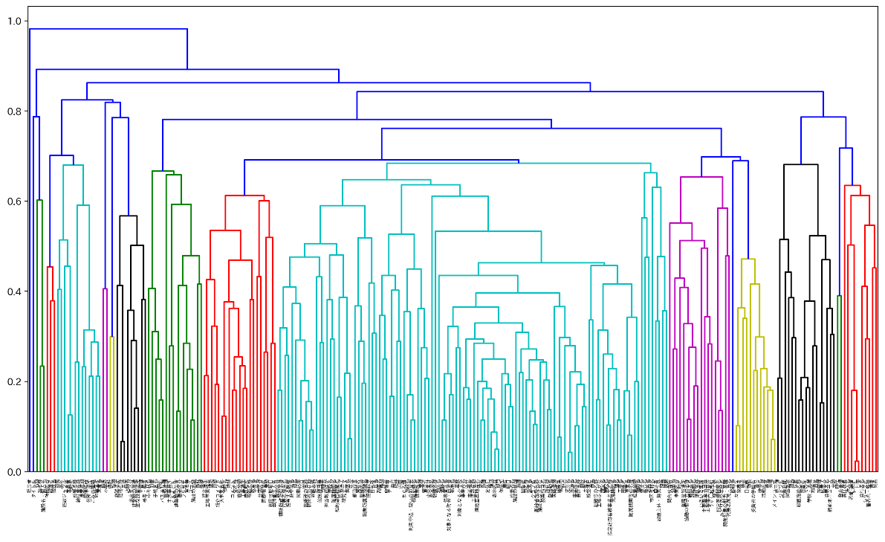
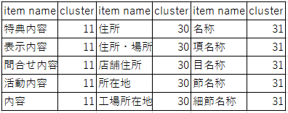
Process flow
START
Get the csv file from open Data
End judgment
Extract item names and item data separated by the word segmentation
Fig. 8. Dendrogram using average's method of the cluster
Create vectors of item names and item with Word2Vec
Perform hierarchical clustering by vectors of item names.
Use Keras to learn for suggestion of predicates by inputting vectors of item data separated and the clustering of item names as teacher signal in output layer.
END
Table.1 Item name’s cluster by hierarchical clustering
Notes:
Next, we perform hierarchical clustering by vectors of item names.
Fig 8 shows the dendrogram using average's method of the hierarchical cluster by cosine distance.
Table.1 shows a part of item name’s cluster when the number of cluster is
50.
15

Slide 16
A | B | C | D | …
a1 | b1 | c1 | d1 | …
a2 | b2 | c2 | d2 | …
: | : | : | :
A | B | C | D | …
a1 | b1 | c1 | d1 | …
a2 | b2 | c2 | d2 | …
: | : | : | :
A | B | C | D | …
a1 | b1 | c1 | d1 | …
a2 | b2 | c2 | d2 | …
: | : | : | :
START
Get the csv file from open Data
Open Data（CSV）
Keras
setting | Parameter
epochs | 100
input layer and hidden layer ‘s activation function | relu
output layer’s activation function | softmax
loss | categorical_crossentropy
optimizer | adam
batch_size | 512
End judgment
Extract item names and item data separated by the word segmentation
Create vectors of item names and item with Word2Vec
Perform hierarchical clustering by vectors of item names.
Use Keras to learn for suggestion of predicates by inputting vectors of item data separated and the clustering of item names as teacher signal in output layer.
END
Table.2 keras’ setting for Deep Learning
Notes:
Finally,we use Keras to learn for suggestion of predicates. Keras is a high-level neural networks API and evaluating deep learning models. Input vectors of item data separated in input layer and the clustering of item names as teacher signal in output layer.
16

Slide 17
Contents
Introduction
  Open Data
  Five stages
  RDF triple
Our search approach
  Word2vec
  Experiment
Experimental results
Conclusion
Notes:
Now, I will show the experimental results.

Slide 18
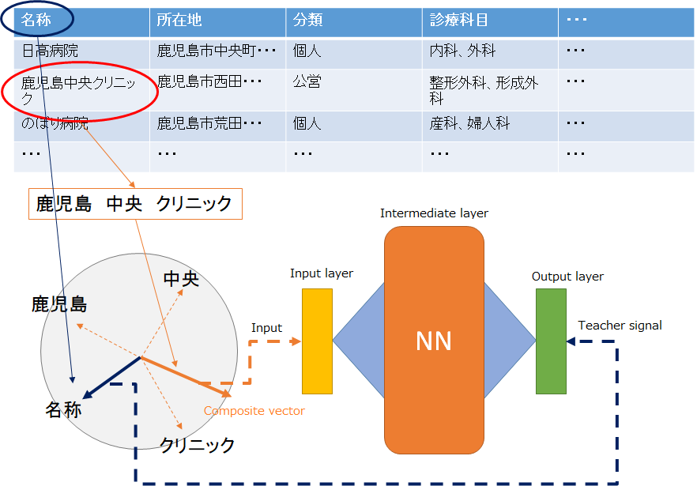
Experimental 1
the clusters of the item names
Fig. 9. Data flow chart
Notes:
This picture shows data flow chart
18

Slide 19
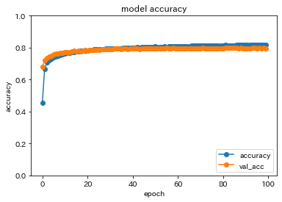
Experimental results
Fig. 10. Accuracy by using the clusters of the item names
Notes:
Fig 12(this picture) shows accuracy when we learned by using the item name’s cluster and Fig 13 shows loss when we learned.
The vertical axis represents accuracy or loss.
The horizontal axis represents epochs which is the number of times we train neural network with the dataset.
19

Slide 20
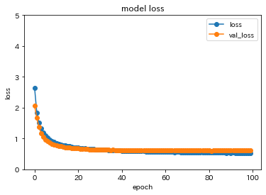
Experimental results
Fig. 11. Loss by using the clusters of the item names
Notes:
Fig 13(this picture) shows loss when we learned.
20

Slide 21
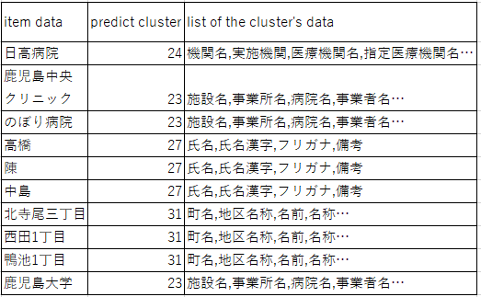
Experimental results
Table.2 Results of predict cluster
Notes:
Table.2(this Table) shows a part of results. From these results, predicting predicate depends on the item name’s cluster by using hierarchical clustering.
Even if the item data are different ,the results of predicted cluster will be the same.
21

Slide 22
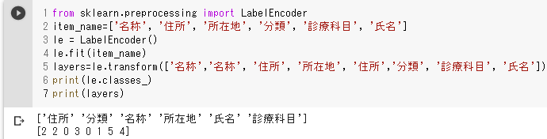
Experiment2
  We have learned under the same condition without using the item name’s cluster
For example: the item name convert to label

Slide 23
Experimental 2
the item names’ label
Fig. 9. Data flow chart
Notes:
This picture shows data flow chart in our
23

Slide 24
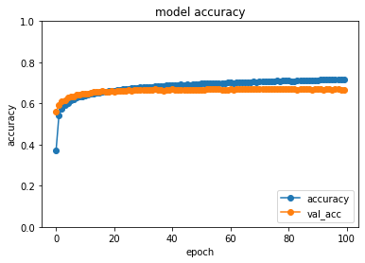
Experimental results
Fig. 12. Accuracy by using the clusters of the item names
Notes:
In addition, we have learned under the same condition without using the item name’s cluster as Fig 10 and Fig 11 show, and then compared the accuracy of Fig 8 with that of Fig 10, we know that the accuracy when using the item name’s cluster is higher than that without using it.
24

Slide 25
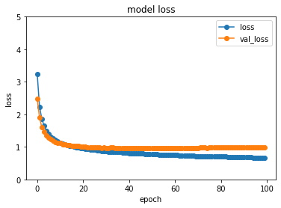
Experimental results
Fig. 13. Accuracy by using the clusters of the item names
Notes:
Fig 13 shows loss when we learned.
25

Slide 26
compared the results
Fig. Accuracy by using the clusters of the item names
Fig. Accuracy by using the clusters of the item names
From results, we know that the accuracy when using the item name’s cluster is higher than that without using it.
Notes:
We compared the results, we know that the accuracy when using the item name’s cluster is higher than that without using it.

Slide 27
CONCLUSION
In this study, we proposed a method to learn word vectors by Keras in order to learn for suggestion of predicates
  confirmed the result of the learning
For further study
  improve the accuracy of the learning method
  convert to RDF format by utilization of the words extracted by Word2Vec
Notes:
In conclusion, we proposed a method to learn word vectors by Keras in order to learn for suggestion of predicates
and confirmed the result of the learning.
And for further study, we will improve the accuracy of the learning method. And then we will convert to RDF format by utilization of the words extracted by Word2Vec.
Thank you for your kind attention.
27

Slide 28
Thank you for your attention!

